Slide 1


DATA ANALYTIC WITH TABELEAU

Slide 2
WELCOME ANNAI WOMENS COLLEGE PUNNAMCHATRAM, KARUR.

Slide 3
UNEARTHING THE ENVIRONMENTAL IMPACT OF HUMAN ACTIVITY: A GLOBAL CO2 EMISSION ANALYSIS

Slide 4
III BSC MATHEMATICS
LEADER :
SUBHASRI.V.P
MEMBERS :
SONIYA AGARWAL.P
SRI VISWA JANANI.K
SRIVARSHINI.S
VARSHINI.P
FACULTY MENTOR:
MRS.K.GOMATHI M.SC.,M.PHIL,

Slide 5
INTRODUCTION
Global warming is one of the biggest challenges currently being faced by the human race, although correlation is not causation, a likely cause of global warming is due to increased atmospheric carbon dioxide from human activities.
CO2 Emission refers to the Carbon Dioxide emitted throughout the world. For this analysis we will be focusing on CO2 Emissions and its effect on the world we live in as well as some key factors and stats that may play a role in the emission of CO2 globally. Fossil fuel use is the primary source of CO2.
The data throws light onto how much fossil fuels are burnt, per year per nation, which amounts to an increase in CO2 every year.
This will help researchers and environment experts to predict global warming. So countries should set a goal to decrease this amount yearly.

Slide 6
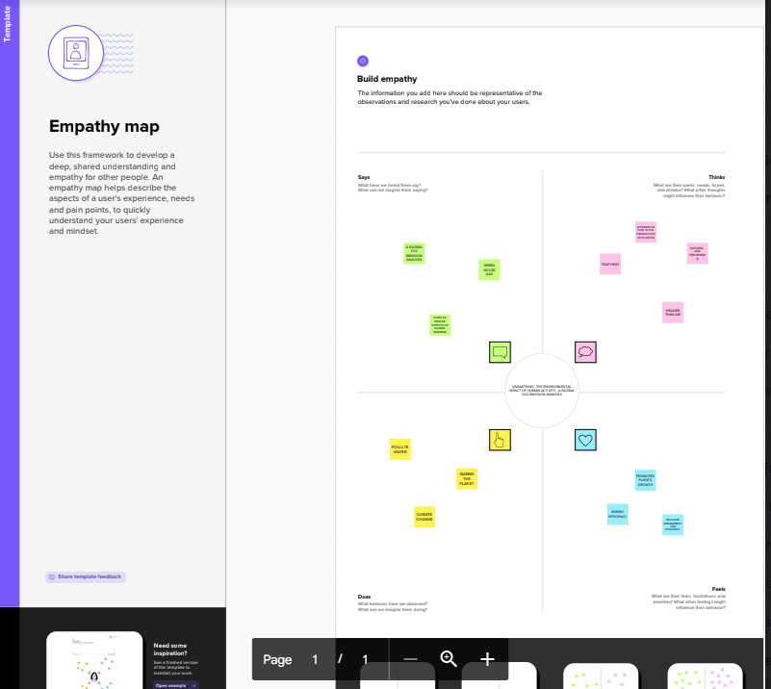
EMPATHY MAP

Slide 7
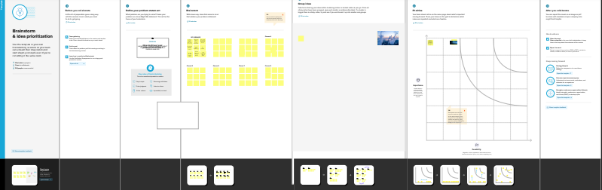
BRAINSTORM

Slide 8
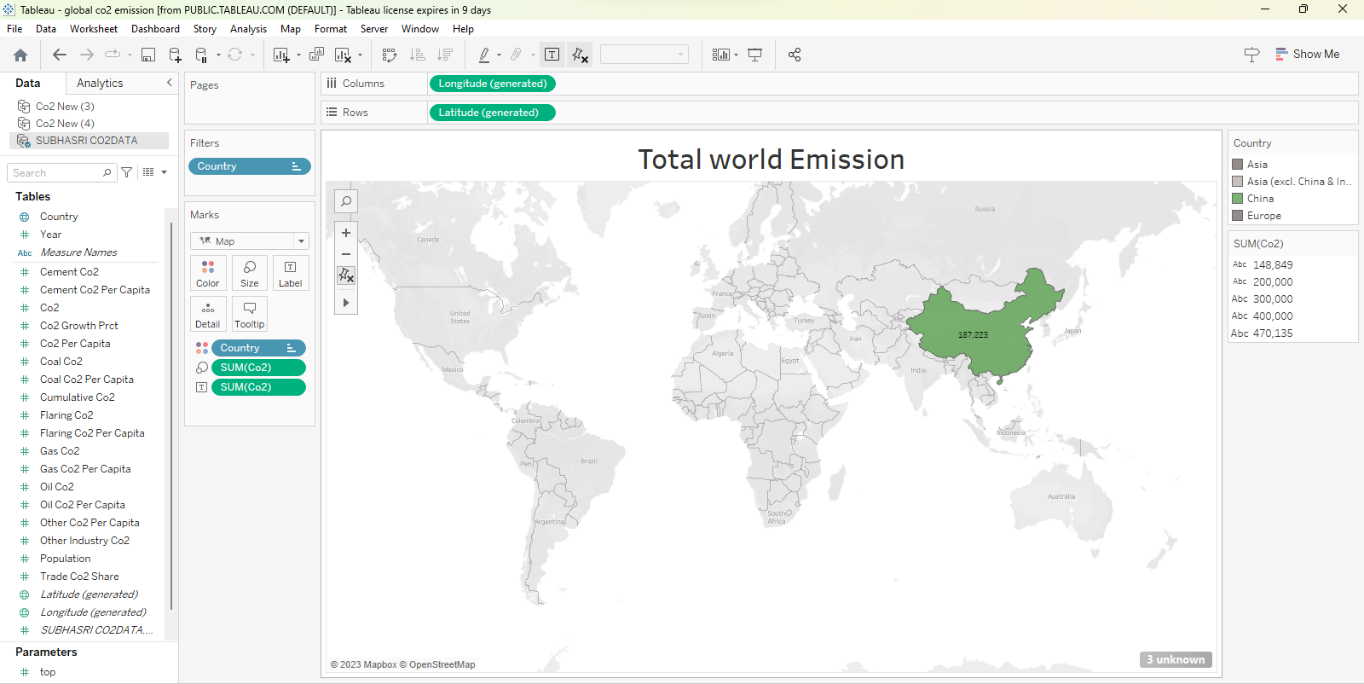
ACTIVITY:01 TOTAL WORLD EMISSION

Slide 9
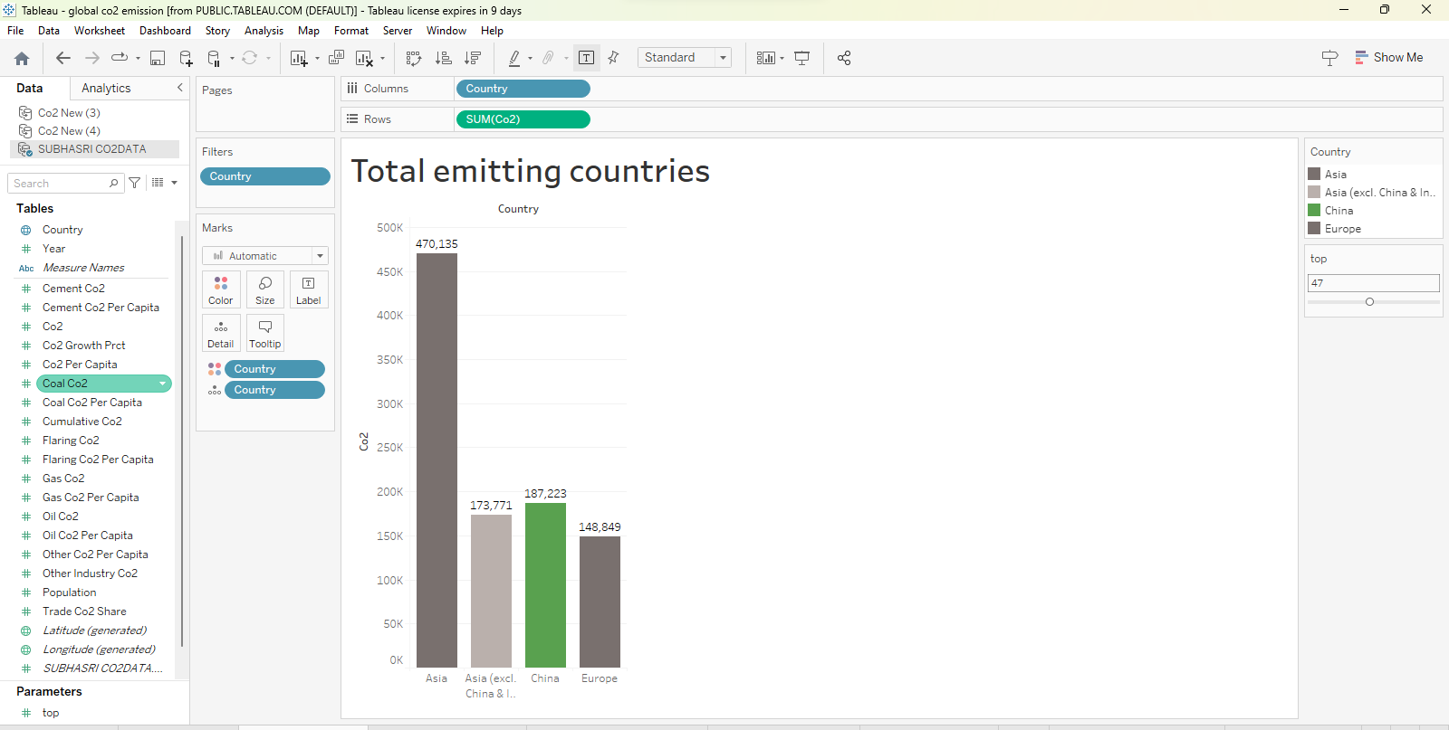
ACTIVITY:02 TOTAL EMITTING COUNTRIES

Slide 10
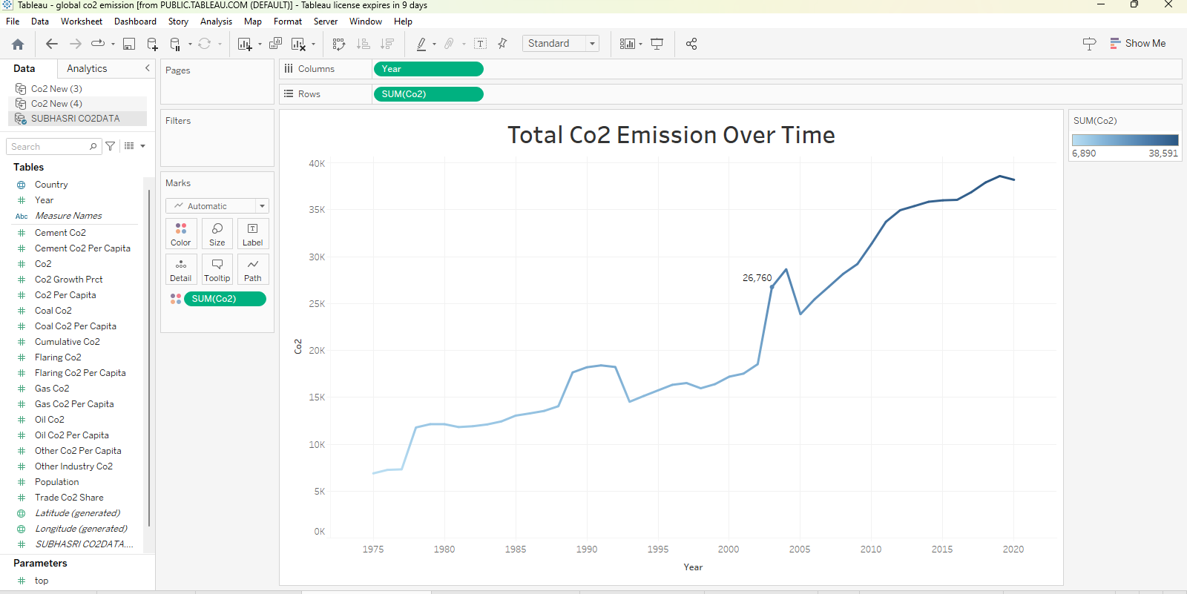
ACTIVITY:04 TOTAL CO2 EMISSION OVER TIME

Slide 11
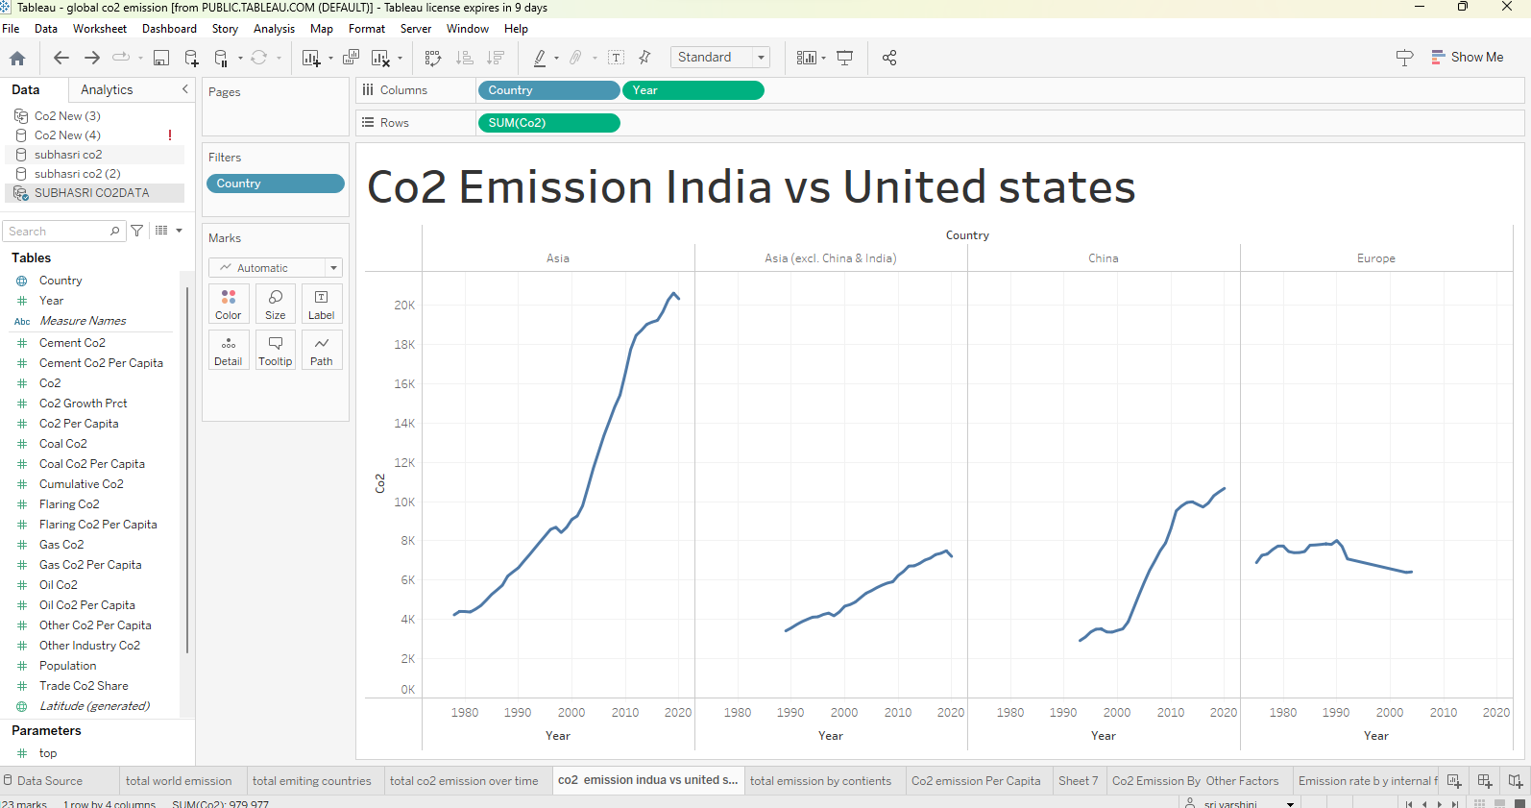
ACTIVITY:05 CO2 EMISSION INDIA VS UNITED STATES

Slide 12
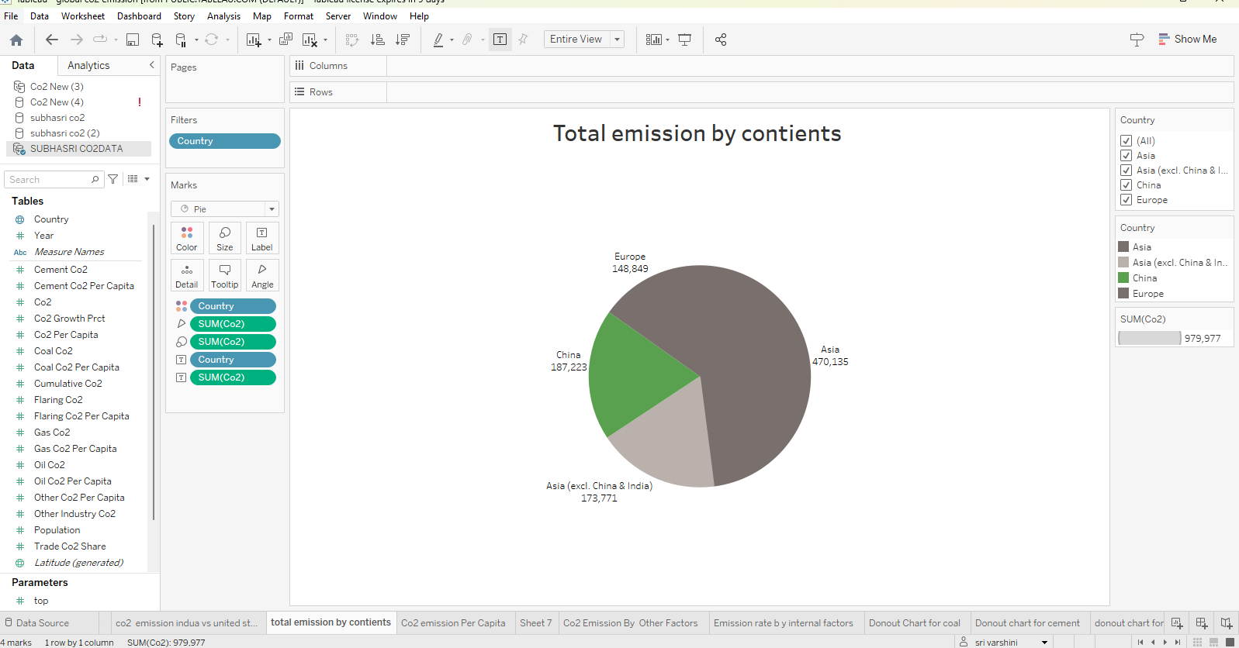
ACTIVITY:06 TOTAL EMISSION BY CONTINENTS

Slide 13
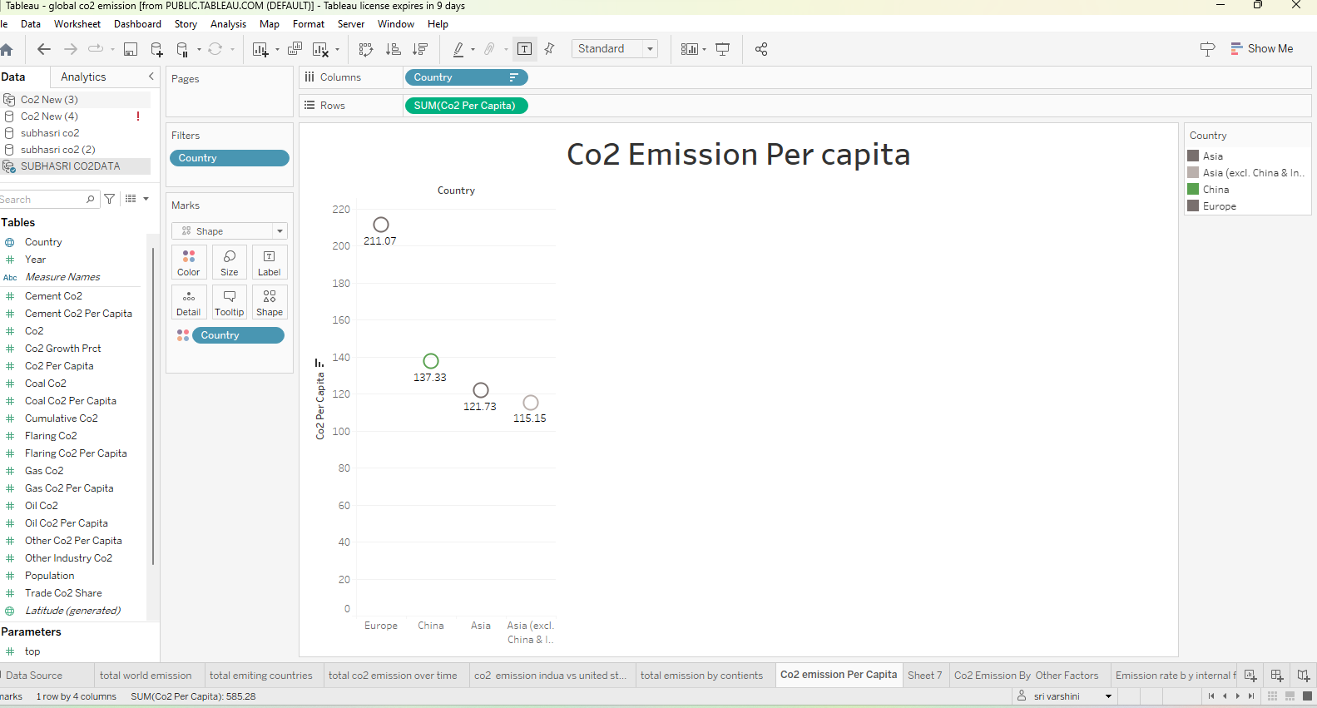
ACTIVITY:07 CO2 EMISSION PER CAPITA

Slide 14
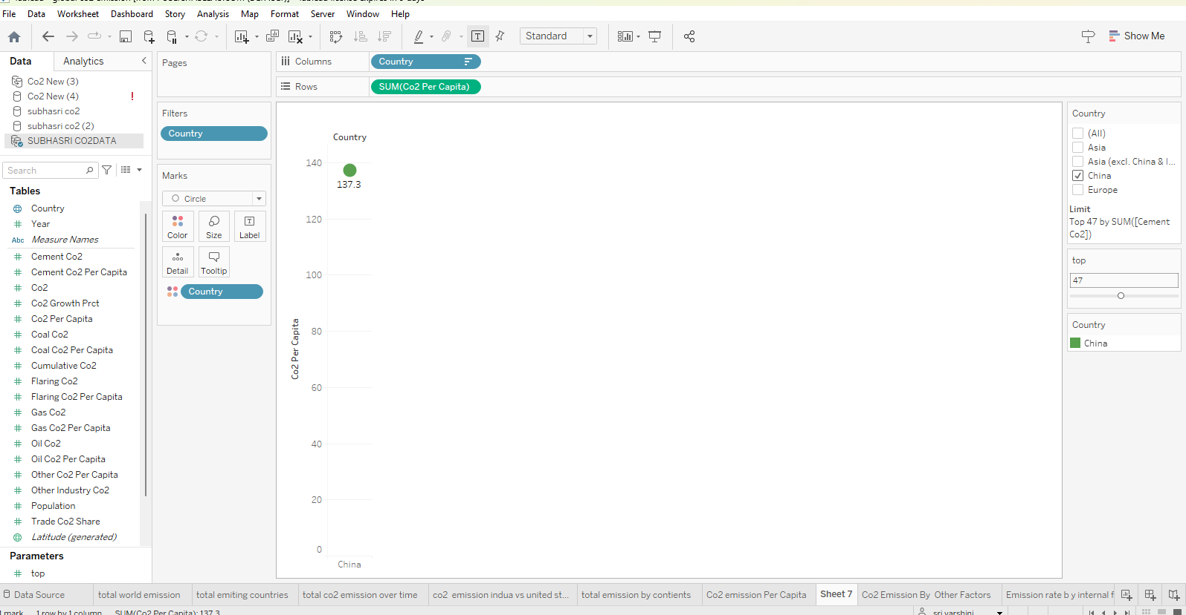
ACTIVITY:08 CO2 EMISSION BY OTHER FACTORS

Slide 15
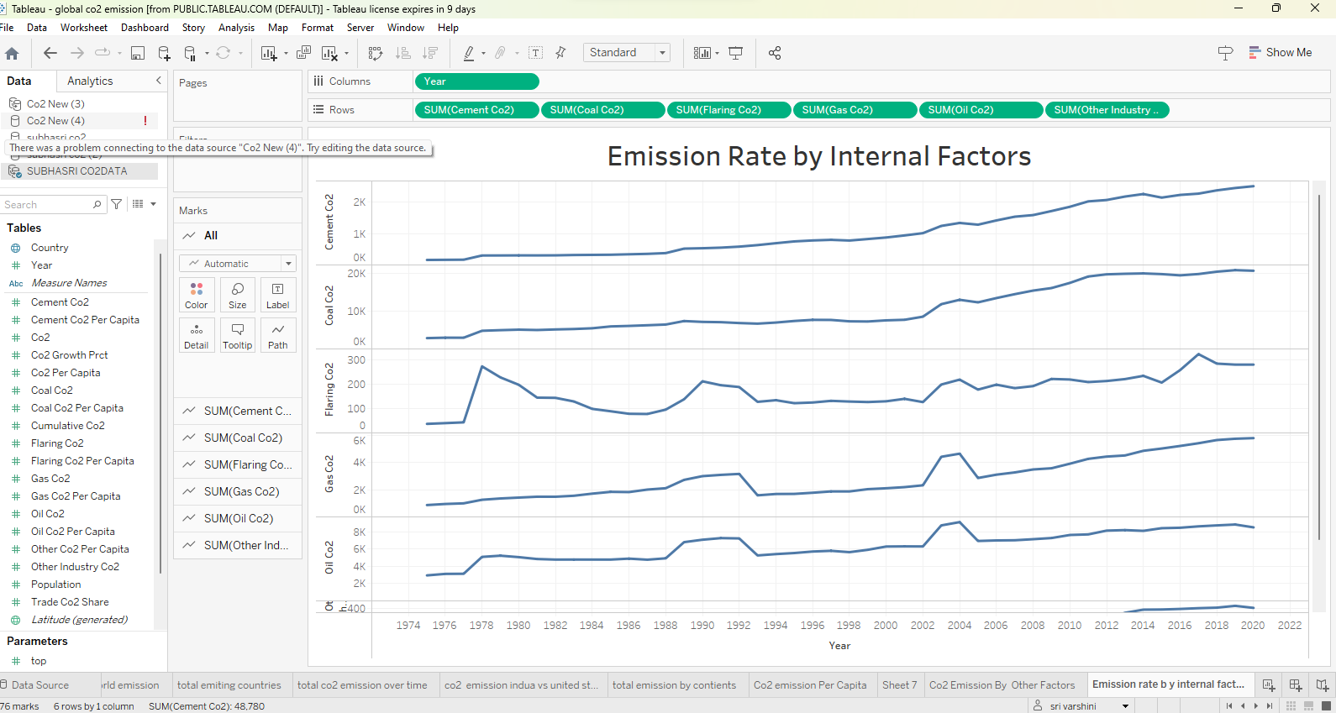
ACTIVITY:09 EMISSION RATE BY INTERNAL FACTORS

Slide 16
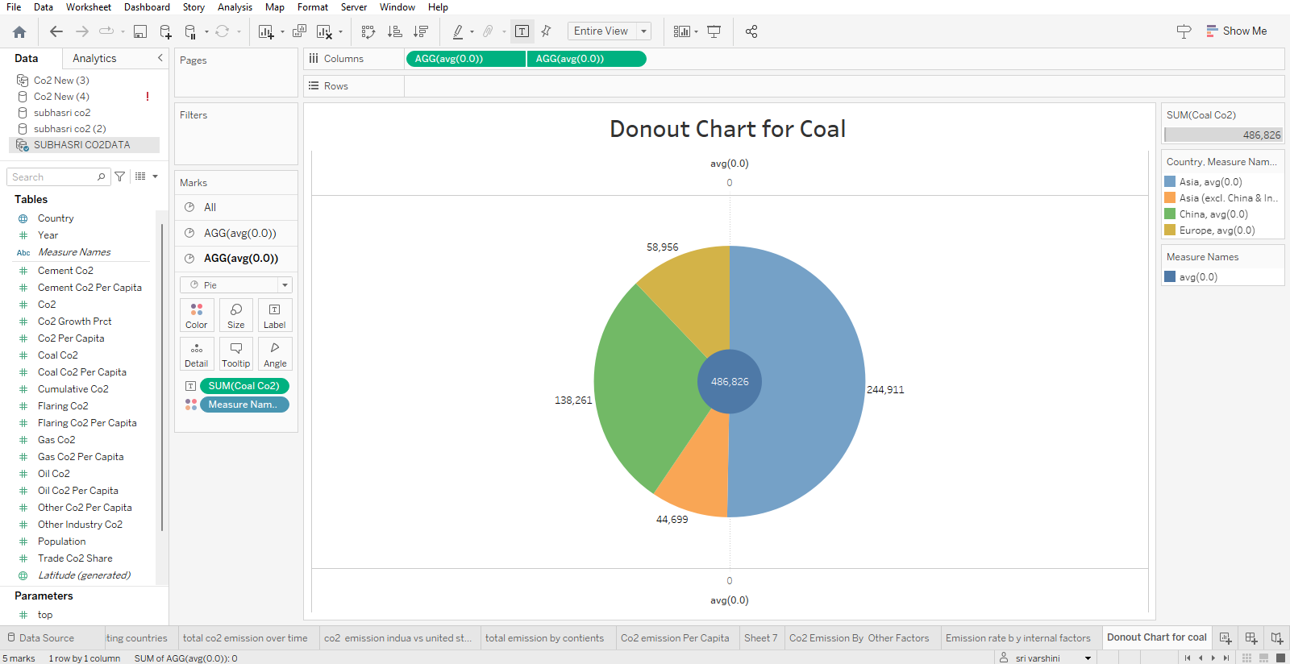
ACTIVITY:10 DONOUT CHART FOR COAL

Slide 17
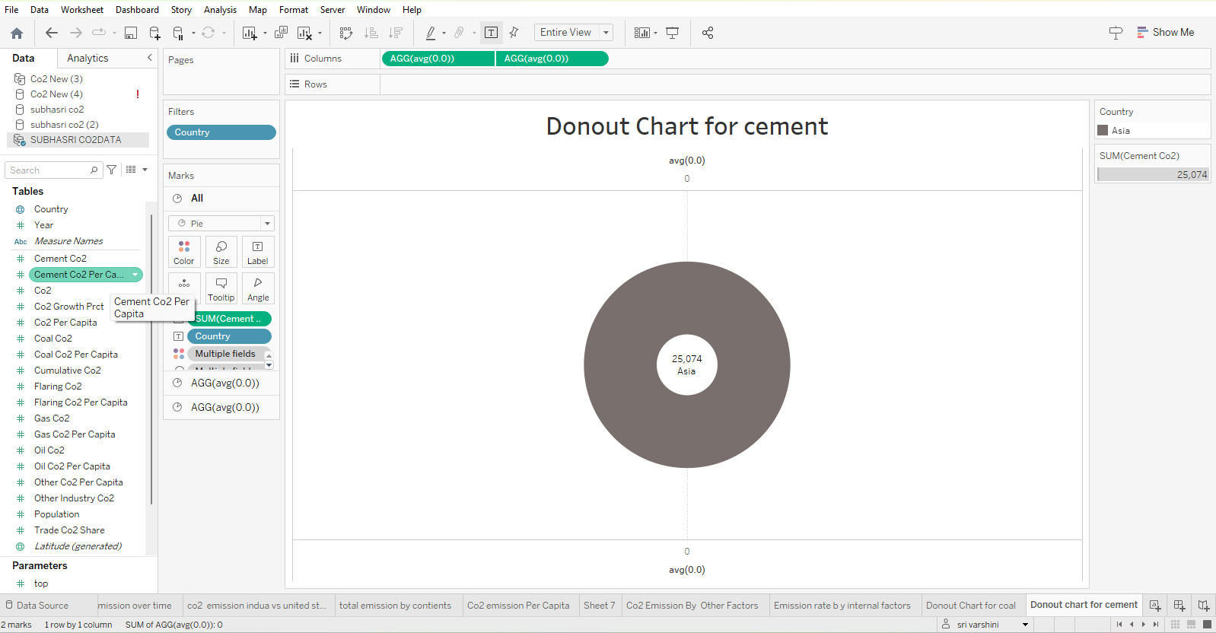
ACTIVITY:11 DONOUT CHART FOR CEMENT

Slide 18
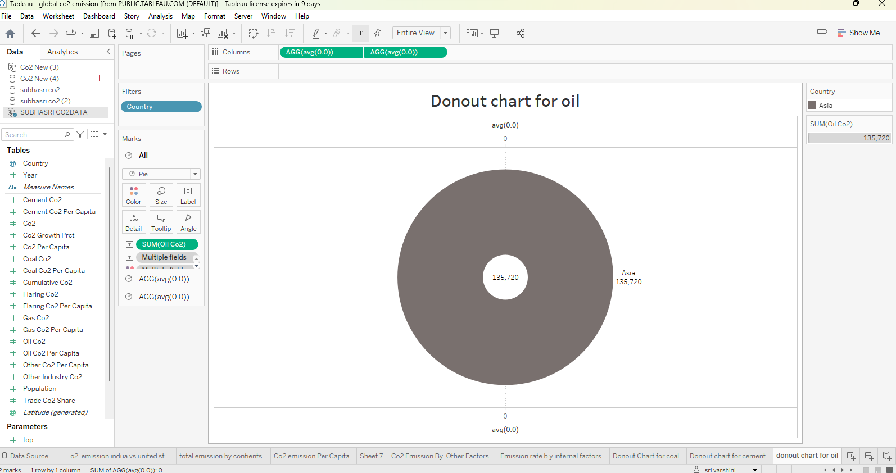
ACTIVITY:12 DONOUT CHART FOR OIL

Slide 19
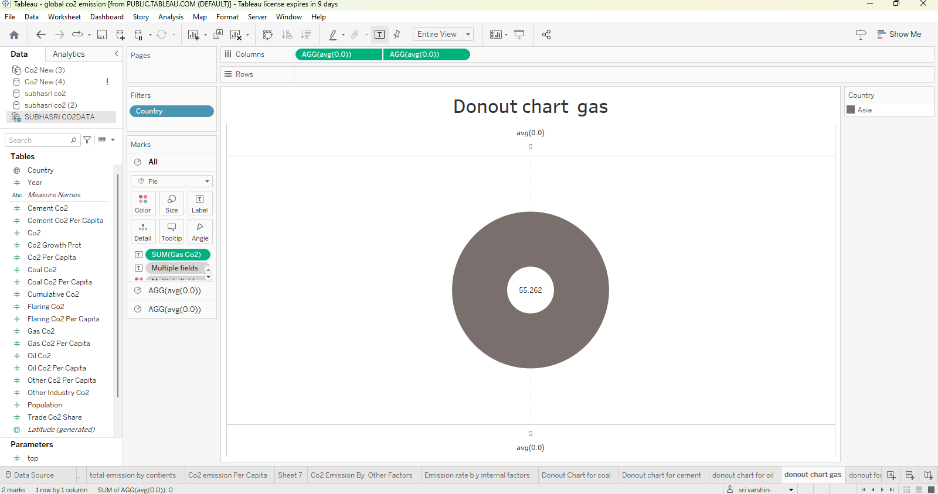
ACTIVITY:13 DONOUT CHART FOR GAS

Slide 20
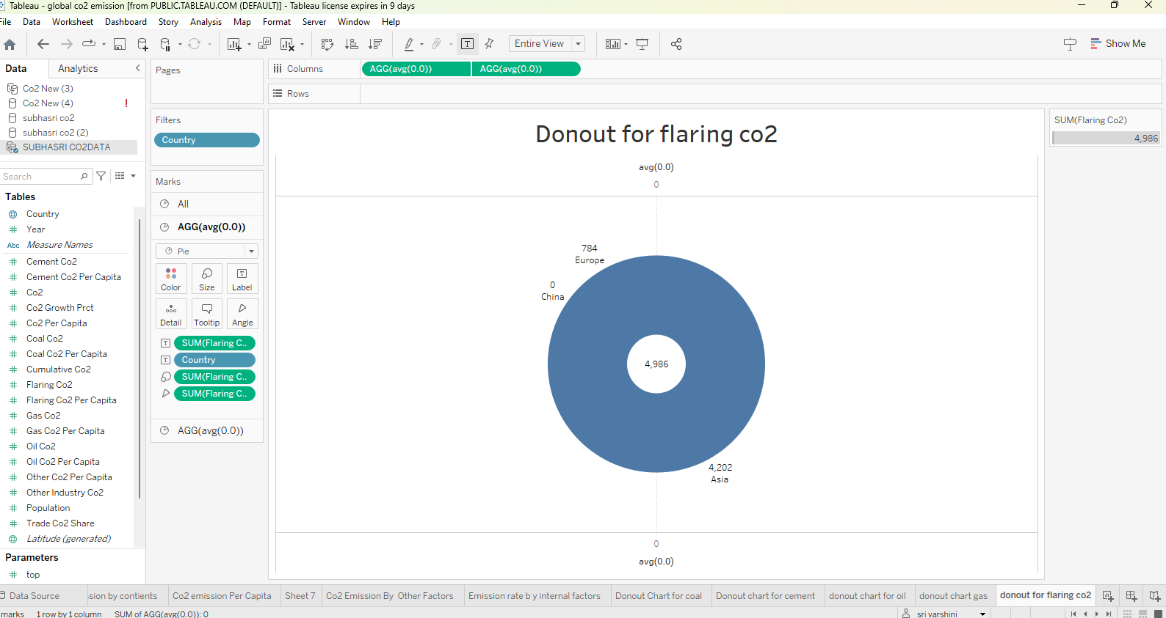
ACTIVITY:14 DONOUT CHART FOR FLARING CO2

Slide 21
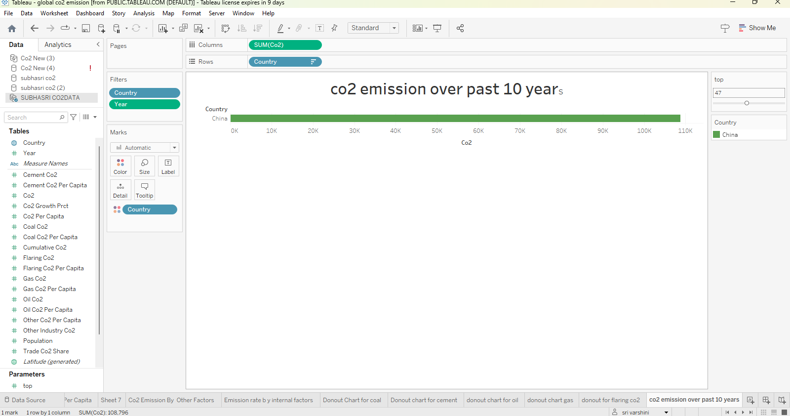
ACTIVITY:15 CO2 EMISSION OVER PAST 10 YEARS

Slide 22
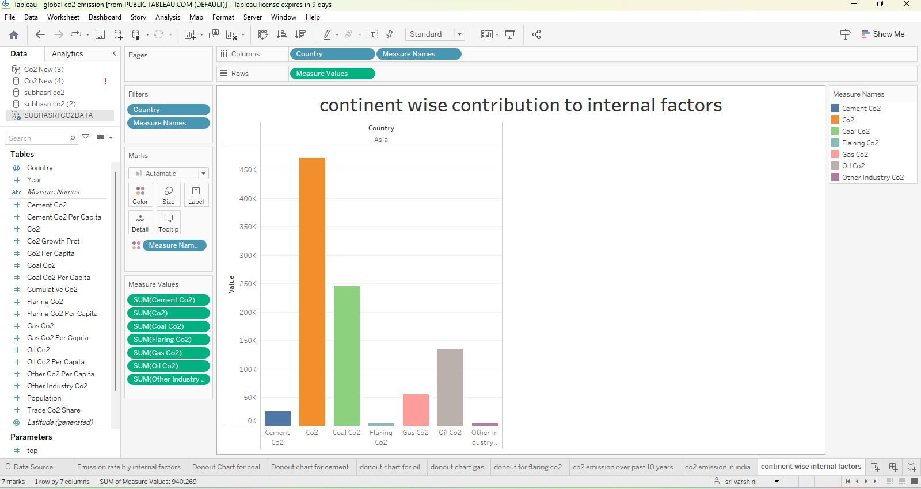
ACTIVITY:16 CONTINENT WISE CONTRIBUTION TO INTERNAL FACTORS

Slide 23
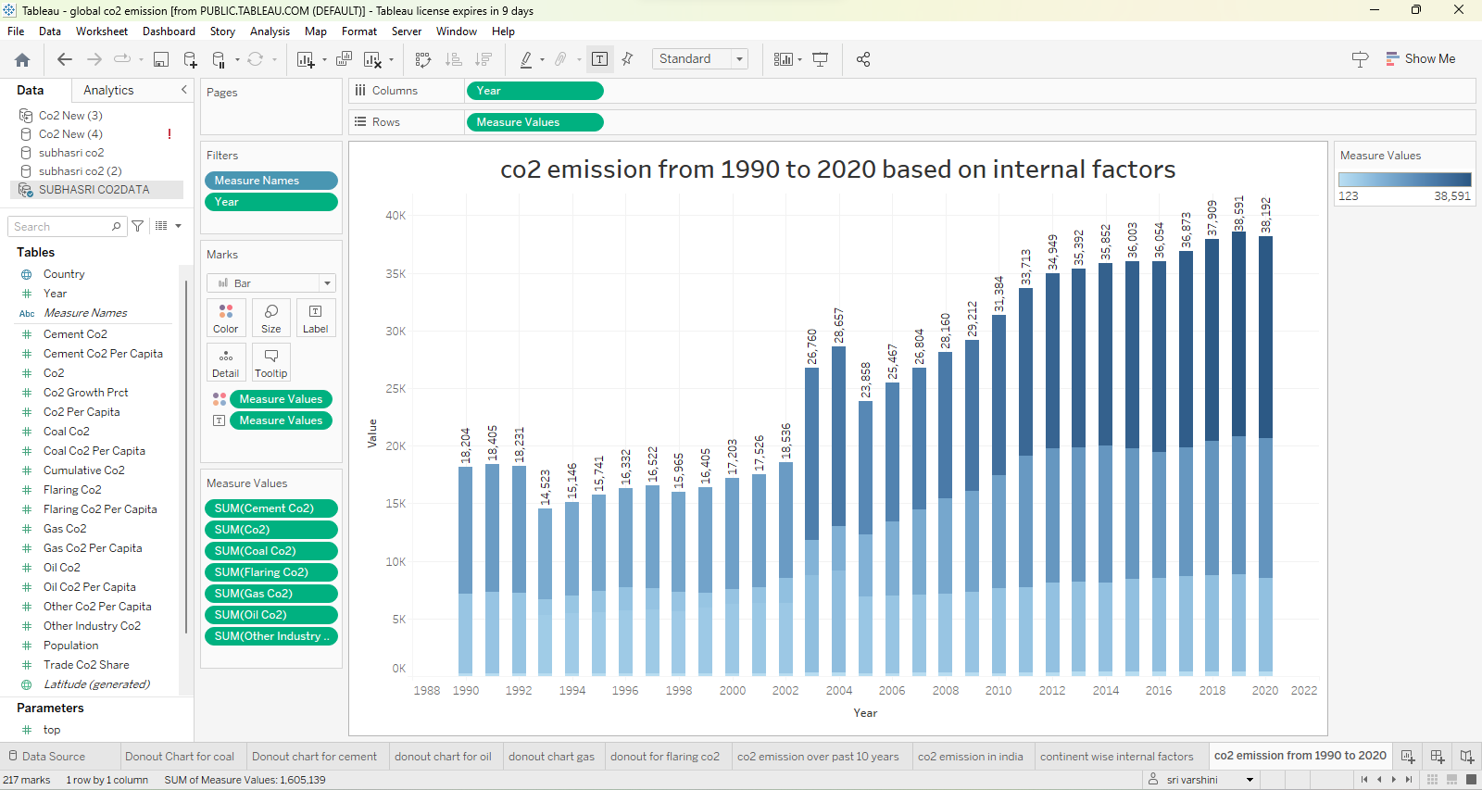
ACTIVITY:17 CO2 EMISSION FROM 1990 TO 2020

Slide 24
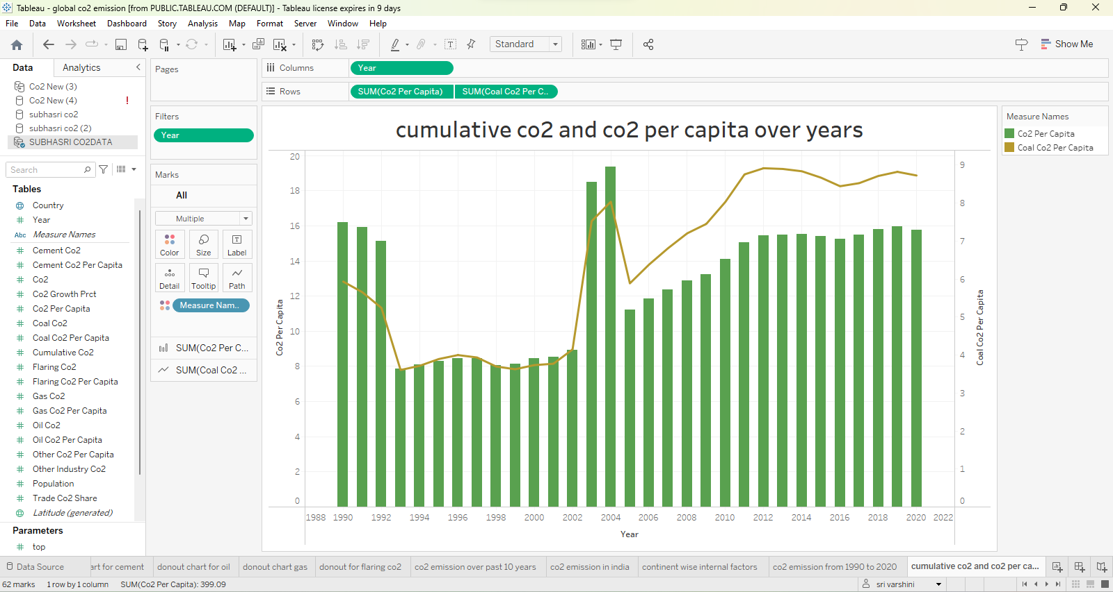
ACTIVITY:18 CUMULATIVE CO2 AND CO2 PER CAPITA

Slide 25
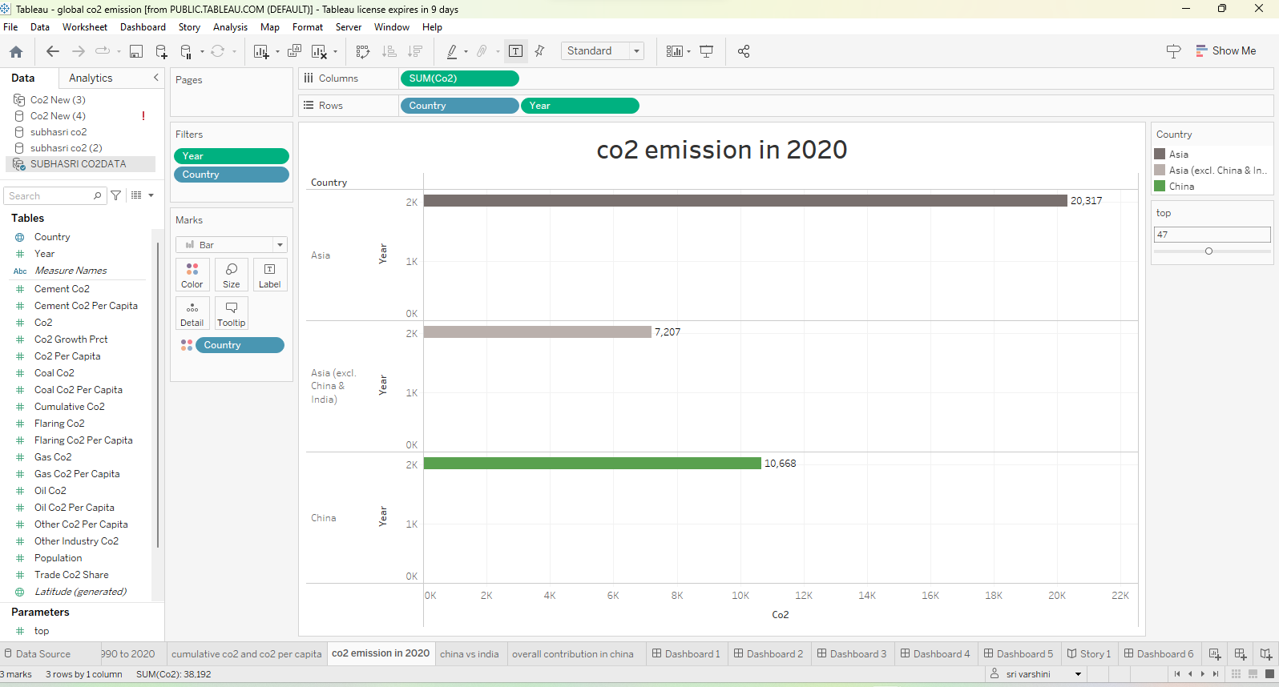
ACTIVITY:19 CO2 EMISSION IN 2020

Slide 26
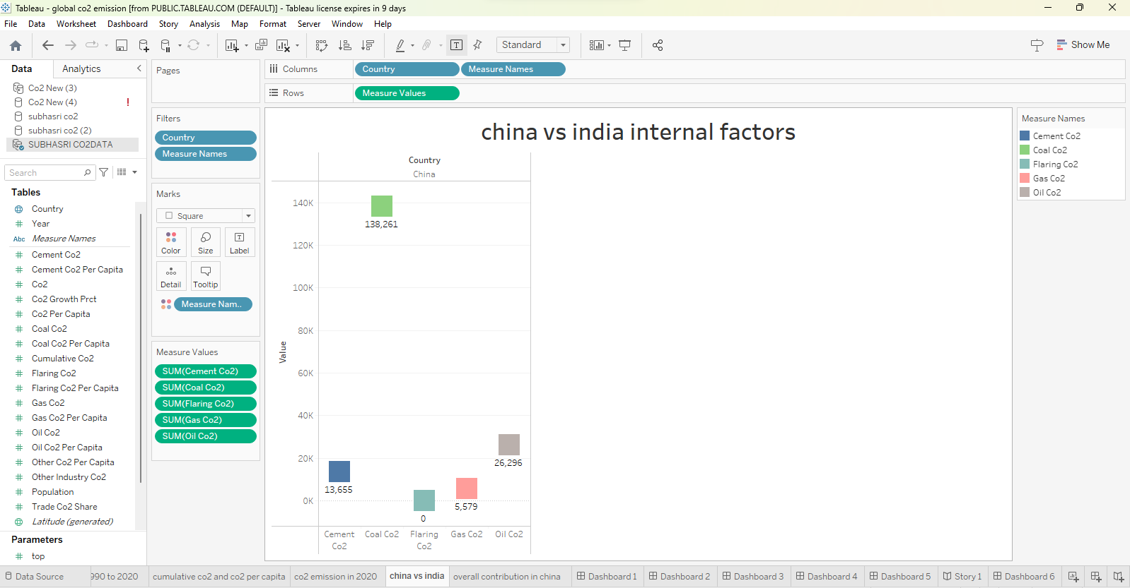
ACTIVITY:20 CHINA VS INDIA INTERNAL FACTORS

Slide 27
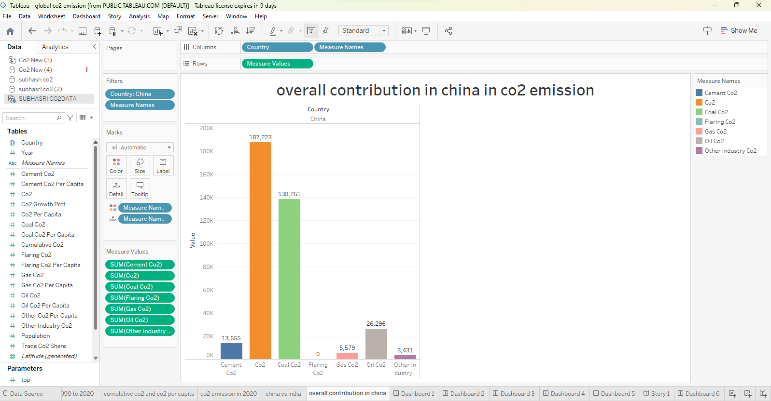
ACTIVITY:21 OVER ALL CONTRIBUTION IN CHINA IN CO2 EMISSION

Slide 28
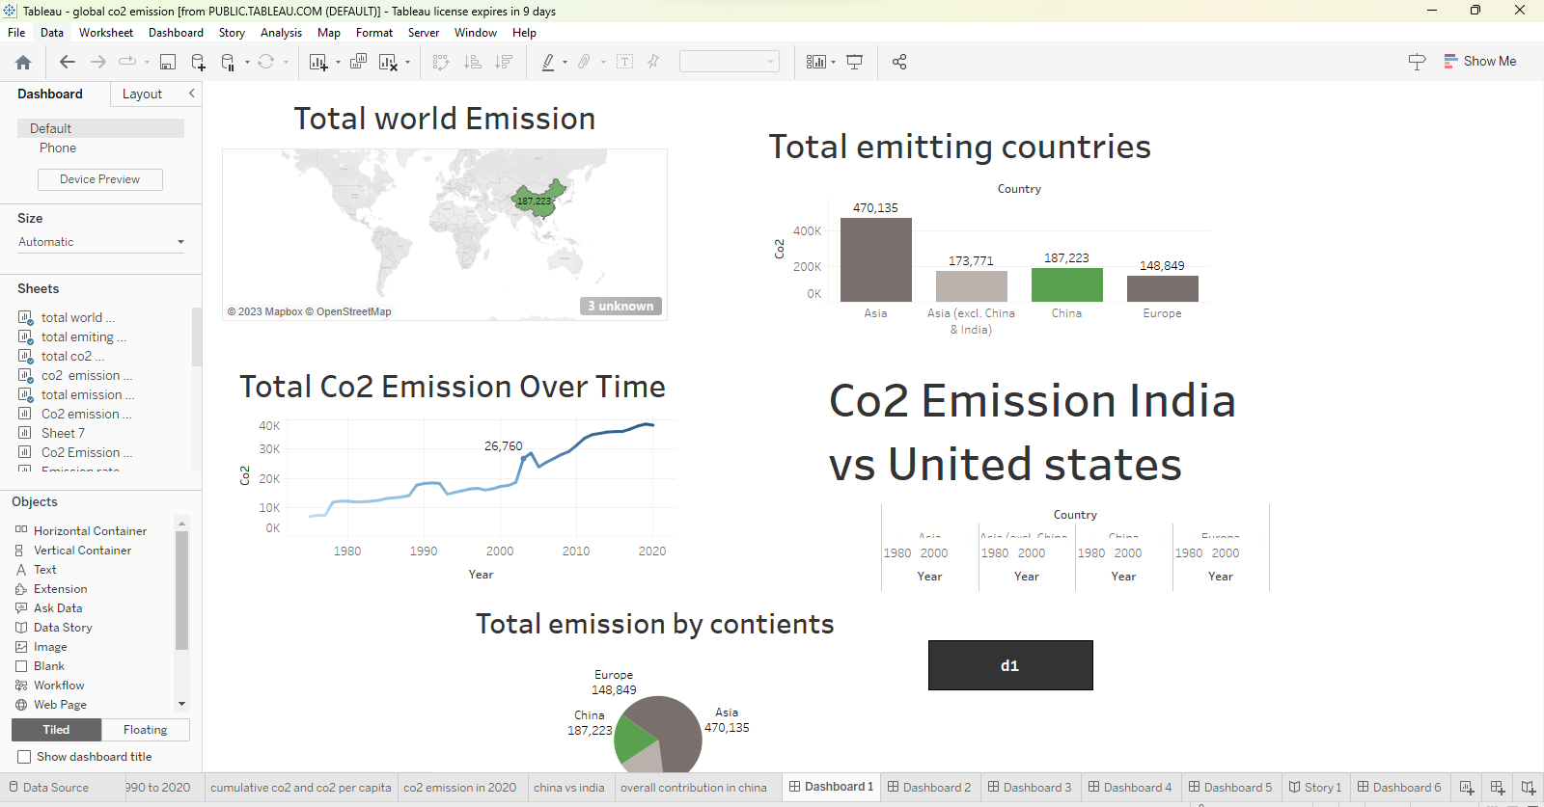
ACTIVITY:22 DASHBOARD 1

Slide 29
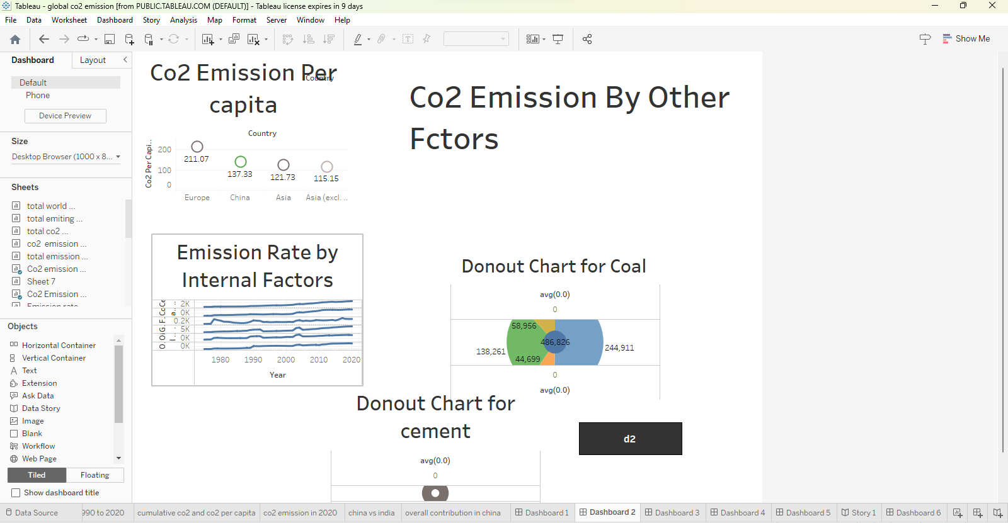
ACTIVITY:23 DASHBOARD 2

Slide 30
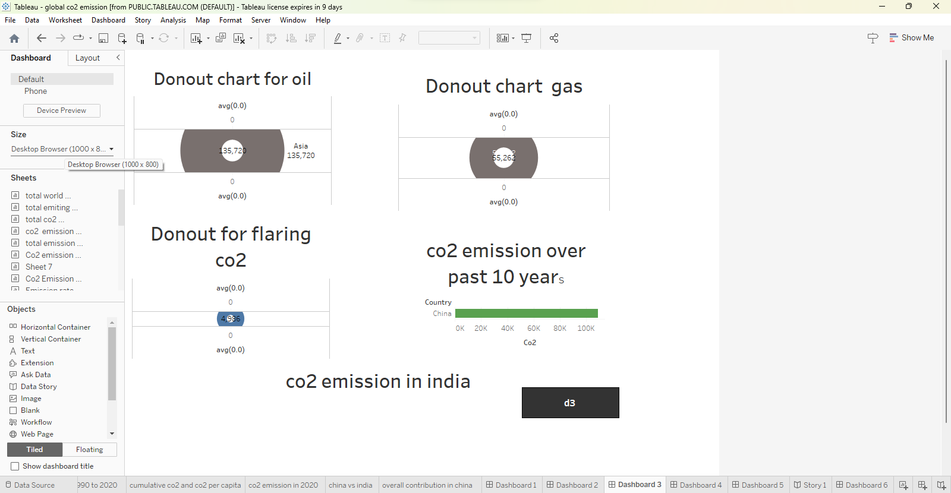
ACTIVITY:23 DASHBOARD 3

Slide 31
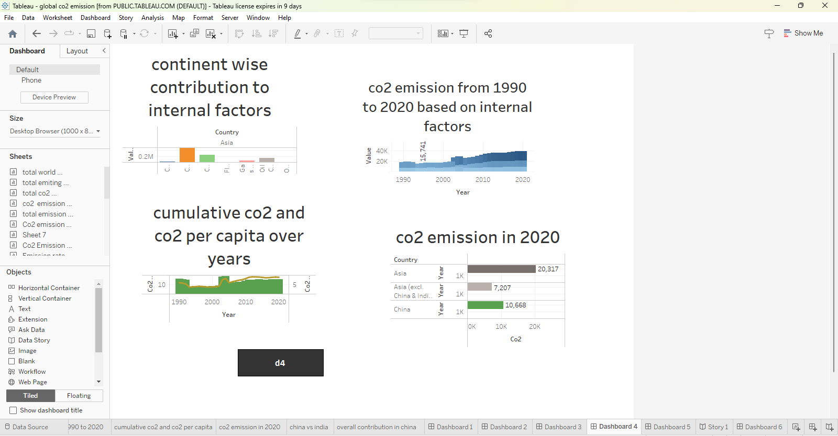
ACTIVITY:24 DASHBOARD 4

Slide 32
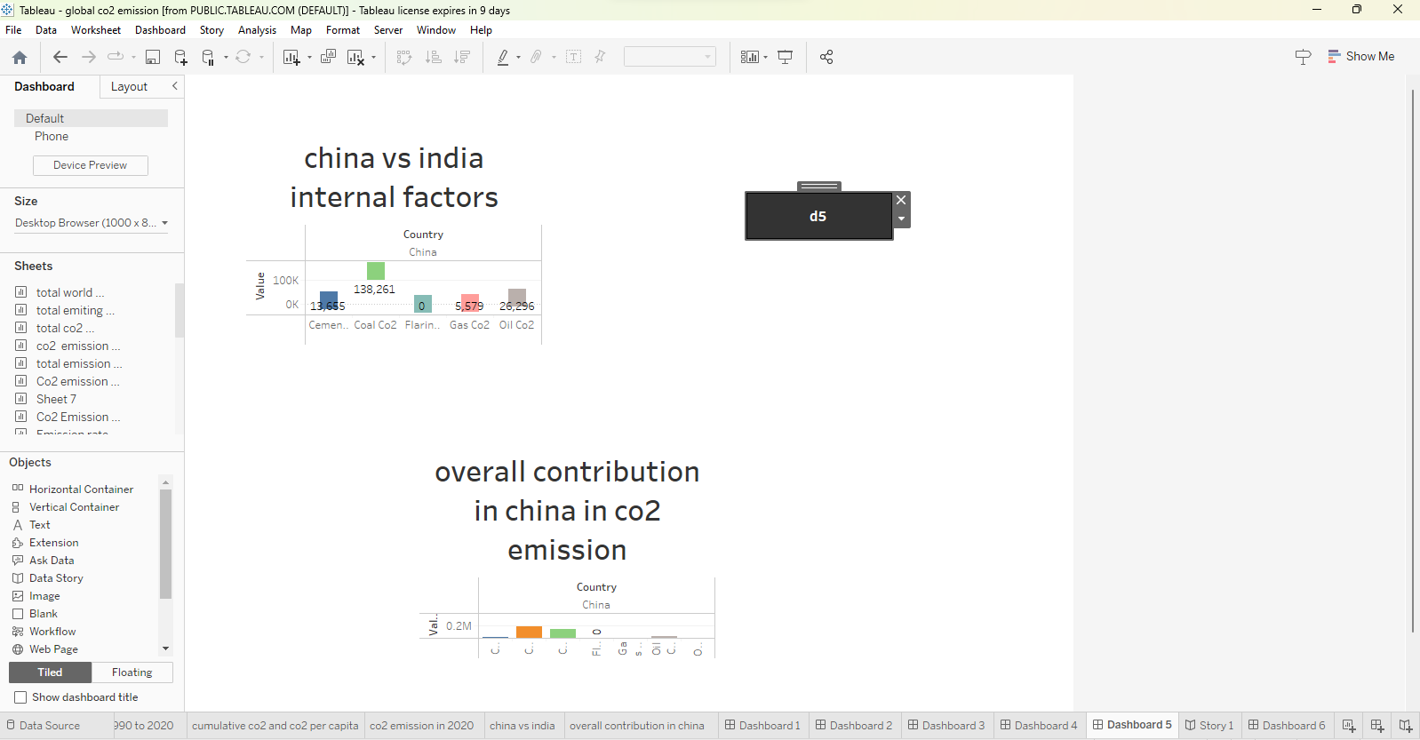
ACTIVITY:25 DASHBOARD 5

Slide 33
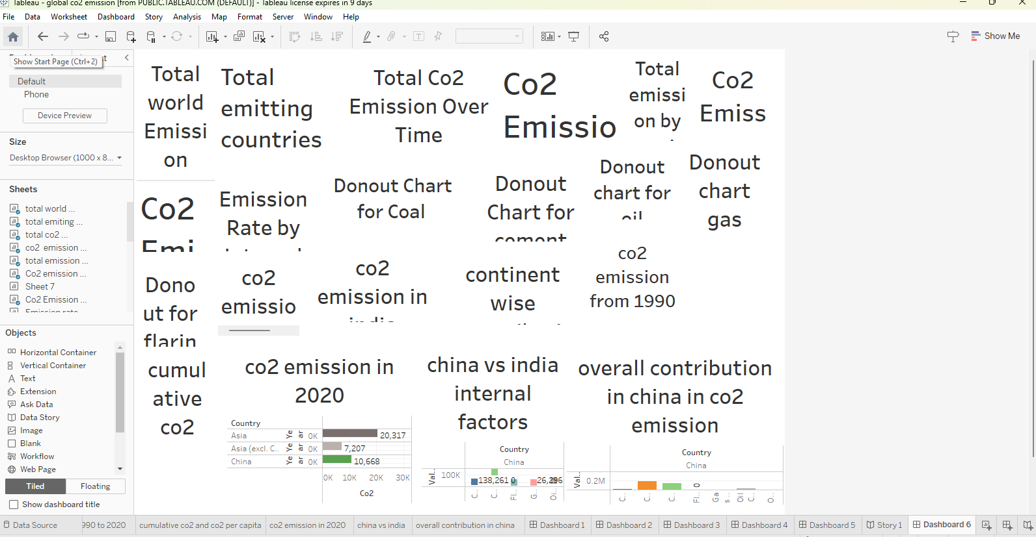
ACTIVITY:26 DASHBOAD 6

Slide 34
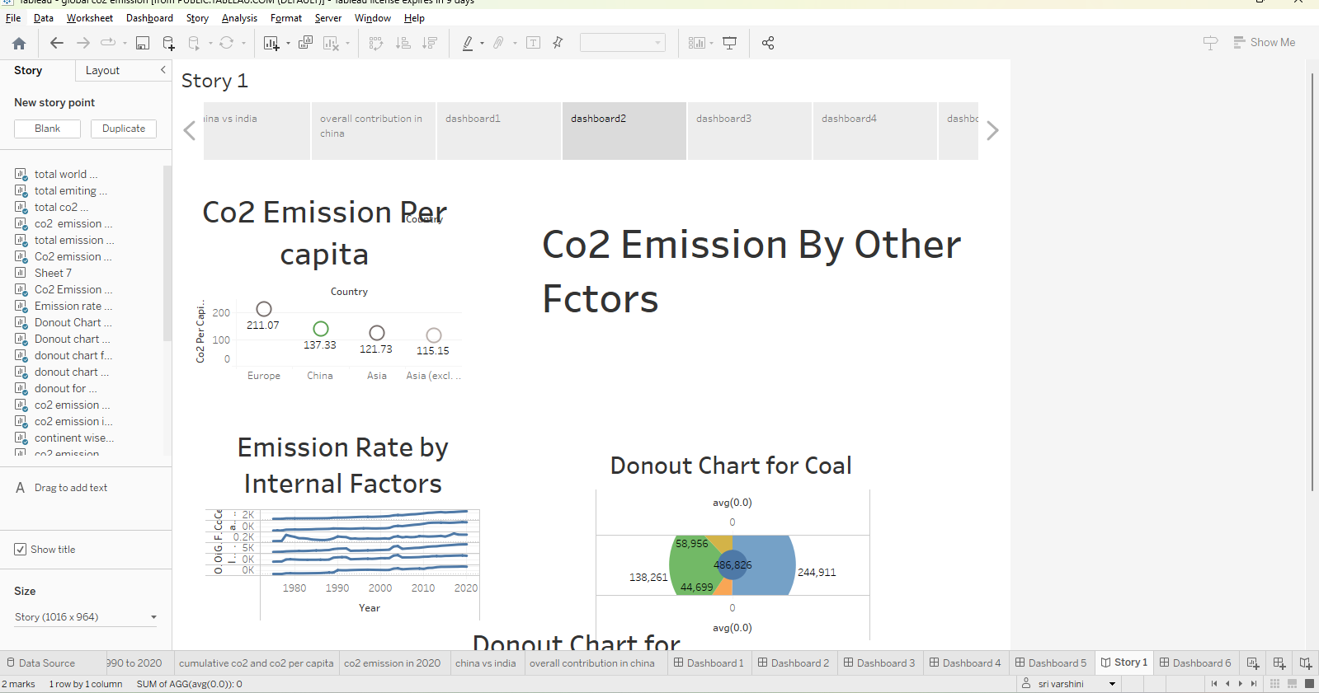
ACTIVITY:27 STORY1

Slide 35
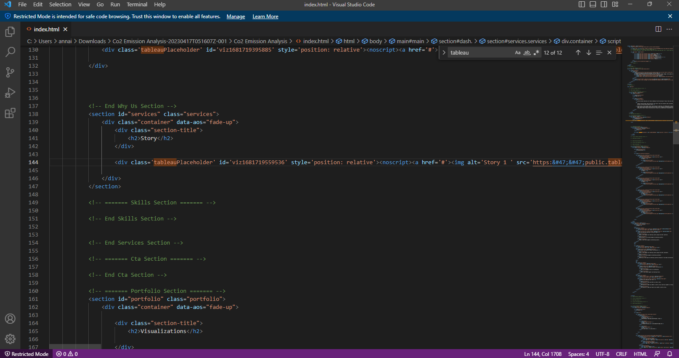
HTML DASHBOARD AND STORY

Slide 36
THANK YOU

